Slide 1
Module 2: SDLC and Security Principles
CYBR 515: Software Security
Summer 2024
Mohammad Jamil Ahmad, Ph.D.

Slide 2
Table of Contents
Software Development: Overview
System Development Lifecycle (SDLC)
Software Security Principles
Software Security Frameworks:
OWASP
MITRE
NIST
Secured SDLC
SDLC models

Slide 3
How are software designed?
The need of “getting something done” is probably the main reason we have software applications.
In the world of business, these are known as business requirements.
Track customers, sales, stock, data.
The origin of a software, is the business/ human requirement.
How can we communicate this need to a team of software developers?

Slide 4
The problem with communicating business requirements
If you give 10 people an image of something (cat, dog, a planet), will they have the same description?
There has to be a systematic way, set of rule, and unified framework to describe that
For example: use “feline” to describe a cat
Use action verbs to describe hat the cat is doing
Use unified language to explain how a business needs their needs satisfied

Slide 5
The Software Development Life Cycle (SDLC)
The Software Development Life Cycle (SDLC) is a structured process used for developing software. It ensures the quality and correctness of the software built. SDLC defines a detailed plan that describes how to develop, maintain, replace, and alter or enhance specific software.
The life cycle defines a methodology for improving the quality of software and the overall development process.

Slide 6
Why is SDLC important?
Structured Process: SDLC provides a systematic approach to software development, ensuring that all aspects of the project are addressed methodically.
Improved Quality: By following predefined phases, the quality of the software is enhanced, reducing the likelihood of errors and defects.
Time Management: Proper planning and phase-wise execution help in meeting deadlines and managing time efficiently.
Cost Efficiency: Identifying and fixing issues early in the development process can significantly reduce costs.
Customer Satisfaction: A well-structured development process ensures that the final product meets the customer's requirements and expectations.

Slide 7
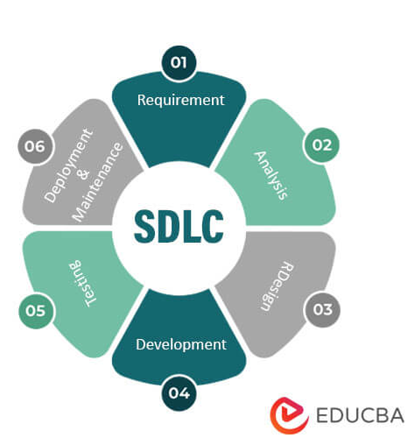
Stages of SDLC
Planning
Requirements Analysis
Design
Implementation (Coding)
Testing
Deployment
Maintenance (some resource combine this with Deployment)

Slide 8
1. Planning
Objective: Define the project goals, scope, resources, schedule, and budget.
Importance: Lays the foundation for the entire project, ensuring alignment with business objectives.
Activities:
Feasibility study
Project charter creation
Resource allocation
Schedule planning
Inputs:
Business idea or problem statement
Preliminary requirements
Outputs:
Project plan
Feasibility report
Budget and timeline

Slide 9
2. Requirements Analysis
Objective: Gather detailed requirements from stakeholders.
Importance: Ensures all stakeholder needs are understood and documented.
Activities:
Stakeholder interviews
Requirements workshops
Use case analysis
Inputs:
Project plan
Preliminary requirements
Outputs:
Requirements specification document (SRS)
Use cases
User stories

Slide 10
3. Design
Objective: Architect the system and create detailed design specifications.
Importance: Provides a blueprint for developers to follow during implementation.
Activities:
System architecture design
Database schema design
User interface design
Inputs:
Requirements specification document
Outputs:
Design specification document
UML diagrams (Class, Sequence, Activity diagrams)
Prototypes

Slide 11
4. Implementation (Coding)
Objective: Develop the software according to the design specifications.
Importance: Translates design into a working software product.
Activities:
Writing code
Code reviews
Unit testing
Inputs:
Design specifications
UML diagrams
Outputs:
Source code
Build scripts
Unit test results

Slide 12
5. Testing
Objective: Verify and validate the software to ensure it meets requirements.
Importance: Detects and fixes bugs before deployment, ensuring software quality.
Activities:
System testing
Integration testing
Performance testing
User acceptance testing (UAT)
Inputs:
Source code
Test plans
Outputs:
Test reports
Bug reports
Test case documents

Slide 13
6. Deployment
Objective: Deploy the software to the production environment.
Importance: Makes the software available for use by end-users.
Activities:
Release planning
Deployment scripts
User training
Inputs:
Tested software
Deployment plan
Outputs:
Deployed software
Installation guides
Training materials

Slide 14
7. Maintenance
Objective: Provide ongoing support and updates to the software.
Importance: Ensures the software remains functional and relevant.
Activities:
Bug fixes
Updates and patches
Performance tuning
Inputs:
Deployed software
User feedback
Bug reports
Outputs:
Updated software
Maintenance logs
Performance reports

Slide 15
Summary of Examples Highlighting What Could Go Wrong in Software Development
Malicious Software Security Attacks
Target Data Attack:
Incident: Approximately 40 million customers were affected by a data breach.
Impact: Massive exposure of personal and financial information.
Facebook-Cambridge Analytica Scandal (2018):
Incident: Unauthorized access to user data through a third-party app's API.
Impact: Data of millions of users was exploited for political advertising.
Myspace XSS Scripting Attack:
Incident: Over one million profiles were infected within 20 hours.
Impact: Rapid spread of malicious scripts affecting a large user base.

Slide 16
Unintended User Mistakes Due to Poor Software Design
NASA's Mars Climate Orbiter:
Incident: Mismatch in metric and imperial units between navigation software and ground control data.
Impact: Incorrect calculations led to the orbiter's failure by approaching Mars at too low an altitude.
Ariane 5 Flight 501:
Incident: Incompatible software reused from Ariane 4 caused a data conversion error.
Impact: Catastrophic failure within 40 seconds of liftoff, resulting in the rocket's destruction.
Therac-25 Radiation Therapy Machine:
Incident: Design flaws and software errors led to race conditions and insufficient testing.
Impact: Patients received massive overdoses of radiation, causing severe harm and fatalities.

Slide 17
Unintended Programmer Mistakes
Heartbleed Bug:
Incident: A programming error in the OpenSSL cryptographic software.
Impact: Allowed attackers to read sensitive data from the memory of thousands of web servers, compromising user privacy.

Slide 18
How can security be integrated into the sdlc? We need to understand the basic security principles first.

Slide 19
Software Security Principles
These are the fundamental practices, guidelines, and frameworks that can helps us designing, developing, and maintaining secured software systems
9. Secure Communication
10. Error Handling
11. Secure Dependencies
12. Security Testing
13. Security Training and Awareness
14. Incident Response
15. Security by Design
16. Secure Development Life Cycle (SDLC)
17. Threat Modeling
1. Least Privilege
2. Defense in Depth
3. Fail-safe Defaults
4. Input Validation
5. Output Encoding
6. Secure Data Storage
7. Authentication and Authorization
8. Session Management

Slide 20
1. Least Privilege
Grant individuals or processes only the minimum access and permissions they need to perform their tasks.
This minimizes the risk of unauthorized access or misuse of privileges.
Example: A database administrator should only have access to the databases they need to manage. If they don't require access to financial databases, their permissions should not include these.

Slide 21
2. Defense in Depth
Implement multiple layers of security controls and safeguards rather than relying on a single security measure.
This approach helps mitigate risks and reduces the impact of security breaches.
Example: A web application might use HTTPS to secure data in transit, employ firewalls to block unauthorized access, and implement intrusion detection systems to monitor for suspicious activity.

Slide 22
3. Fail-safe Defaults
Systems and applications should be configured to operate securely by default.
If a configuration or access control is not explicitly defined, it should be denied or disabled.
Example: A file-sharing system should default to private settings for new files, ensuring only the owner can access them unless additional permissions are granted.

Slide 23
4. Input Validation
Validate and sanitize all user inputs to prevent injection attacks, such as SQL injection and cross-site scripting (XSS).
This ensures that data is safe before being processed.
Example: A login form should validate the entered username and password to ensure they meet expected formats and lengths, and sanitize inputs to remove any potentially malicious code.

Slide 24
5. Output Encoding
Encode data before displaying it to users to prevent attacks like XSS by treating potentially malicious input as data, not executable code.
Example: An application displaying user comments should encode special characters (e.g., <, >, &, ") to prevent them from being interpreted as HTML or JavaScript.

Slide 25
6. Secure Data Storage
Use strong encryption and access controls to protect sensitive data at rest. Encrypting data in databases, files, and other storage locations ensures it's secure even if accessed improperly.
Example: Customer information stored in a database should be encrypted using AES-256 encryption, and access to this data should be restricted based on roles.

Slide 26
7. Authentication and Authorization
Implement robust authentication mechanisms to verify user identities and authorization controls to ensure users can only access permitted resources and functionality.
Example: A banking app uses multi-factor authentication (MFA) for login and role-based access controls to ensure users can only view their own accounts and not others'.

Slide 27
8. Session Management
Properly manage and secure user sessions to prevent session fixation, session hijacking, and other session-related attacks.
Example: A web application should generate a new session ID after a successful login and use secure cookies with the HttpOnly and Secure flags.

Slide 28
9. Secure Communication
Use secure protocols like HTTPS to protect data transmitted between clients and servers.
Example: An online shopping site uses HTTPS to encrypt all data exchanged between the user's browser and the server, protecting credit card information during transactions.

Slide 29
10. Error Handling
Implement appropriate error handling and reporting mechanisms to provide minimal information to users while logging detailed error messages for administrators.
Example: A web application should display a generic error message ("An error occurred, please try again later") to users while logging detailed technical information about the error for developers.

Slide 30
11. Secure Dependencies
Regularly update and patch all software components and libraries to address known vulnerabilities.
Ensure third-party dependencies are secure and up to date.
Example: A developer should regularly check for updates to libraries like OpenSSL and apply patches to fix known security vulnerabilities such as Heartbleed.

Slide 31
12. Security Testing
Conduct thorough security testing, including code reviews, penetration testing, and vulnerability scanning, to identify and remediate security issues in the software.
Example: A company conducts regular penetration tests on its web application to identify and fix security vulnerabilities before attackers can exploit them.

Slide 32
13. Security Training and Awareness
Promote security awareness among developers, users, and administrators and provide training to ensure they understand and follow security best practices.
Example: Regular security training sessions for developers on the latest secure coding practices and awareness programs for employees on recognizing phishing attacks.

Slide 33
14. Incident Response
Develop a plan to effectively respond to security breaches and minimize their impact.
Example: A company has an incident response team that follows a detailed plan to contain, investigate, and remediate security incidents such as data breaches.

Slide 34
15. Security by Design
Consider security from the initial stages of software design and architecture rather than attempting to bolt security onto a finished product.
Example: During the design phase of a new application, developers include threat modeling and security requirements to ensure the system is secure from the start.

Slide 35
16. Secure Development Life Cycle (SDLC)
Implement a secure software development life cycle incorporating security activities at each development phase, from requirements to deployment.
Example: In the SDLC for a mobile banking app, each phase includes security reviews, from planning and requirements gathering to coding, testing, and deployment.

Slide 36
17. Threat Modeling
Identify and assess potential threats and vulnerabilities specific to your application, allowing proactive security measures.
Example: During the design phase of a new e-commerce platform, developers create threat models to identify and mitigate risks like SQL injection, XSS, and data breaches.

Slide 37
FRAMEWORKS TO BE AWARE OF AND FAMILIAR WITH
Open Web Application Security Project (OWASP)
The National Institute of Standards and Technology (NITS) Secure Software Development Framework
MITRE frameworks
Common SDLC models
Microsoft’s Security Development Lifecycle
Confidentiality, integrity, and availability (C-I-A)

Slide 38
1. Open Web Application Security Project (OWASP)
The Open Web Application Security Project (OWASP) is a nonprofit, community-driven, foundation dedicated to improving the security of software.
OWASP provides free and open resources, such as tools, documentation, forums, and projects, to help organizations build secure software.
Key Resources:
OWASP Top Ten: A list of the top ten most critical web application security risks.
OWASP ZAP (Zed Attack Proxy): A tool for finding vulnerabilities in web applications.
OWASP ASVS (Application Security Verification Standard): A framework for testing the security of web applications.

Slide 39
OWASP top 10
Description: The OWASP Top 10 is a list of the top 10 most critical web application security risks.
Purpose: Serves as a guideline for developers and organizations to prioritize their security efforts.
Importance: Helps in identifying and mitigating the most prevalent and critical security vulnerabilities.

Slide 40
OWASP top 10 resources
A must watch and read resources about OWASP top 10
https://www.synopsys.com/glossary/what-is-owasp-top-10.html)
https://www.cloudflare.com/learning/security/threats/owasp-top-10/
https://www.cyberdb.co/real-world-examples-for-owasp-top-10-vulnerabilities/

Slide 41
OWASP top 10 list
Injection
Broken Authentication
Sensitive Data Exposure
XML External Entities (XXE)
Broken Access Control
Security Misconfiguration
Cross-Site Scripting (XSS)
Insecure Deserialization
Using Components with Known Vulnerabilities
Insufficient Logging & Monitoring

Slide 42
OWASP top 10 - Injection
Description: Injection flaws, such as SQL, NoSQL, OS, and LDAP injection, occur when untrusted data is sent to an interpreter as part of a command or query.
Impact: Attackers can execute arbitrary commands or access data without proper authorization.
How to Secure:
Use parameterized queries.
Validate and sanitize inputs.

Slide 43
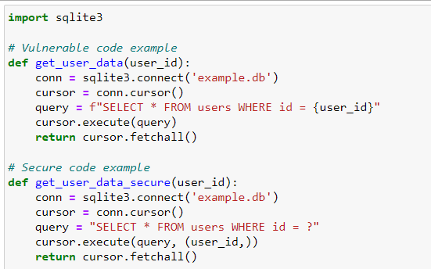
OWASP top 10 – Injection example

Slide 44
OWASP top 10 - Broken Authentication
Description: Broken authentication vulnerabilities allow attackers to compromise passwords, keys, or session tokens, or to exploit other implementation flaws to assume other users' identities.
Impact: Unauthorized access to user accounts and data.
How to Secure:
Implement multi-factor authentication (MFA).
Use secure password storage techniques.

Slide 45
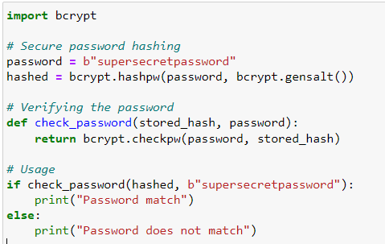
OWASP top 10 - Broken Authentication example

Slide 46
OWASP top 10 - Sensitive Data Exposure
Description: Sensitive data exposure vulnerabilities occur when sensitive data is not properly protected.
Impact: Unauthorized access to sensitive information, such as credit card data, personal information, etc.
How to Secure:
Use encryption for data at rest and in transit.
Implement strong access controls.

Slide 47
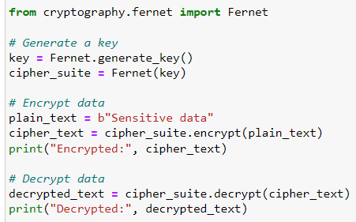
OWASP top 10 - Sensitive Data Exposure example

Slide 48
OWASP top 10 - XML External Entities (XXE)
Description: XXE vulnerabilities occur when XML input containing a reference to an external entity is processed by a weakly configured XML parser.
Impact: Attackers can access internal files and services.
How to Secure:
Disable DTDs (Document Type Definitions) in XML parsers.
Use less powerful data formats like JSON.

Slide 49
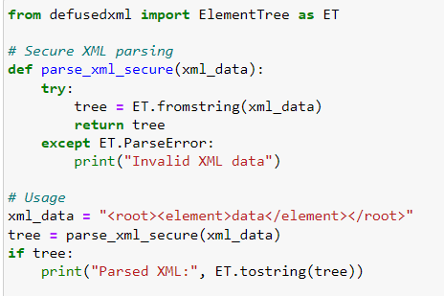
OWASP top 10 - XML External Entities (XXE) example

Slide 50
OWASP top 10 - Broken Access Control
Description: Broken access control vulnerabilities occur when restrictions on authenticated users are not properly enforced.
Impact: Attackers can access unauthorized functionality or data.
How to Secure:
Implement proper access controls and regularly review them.
Use role-based access control (RBAC).

Slide 51
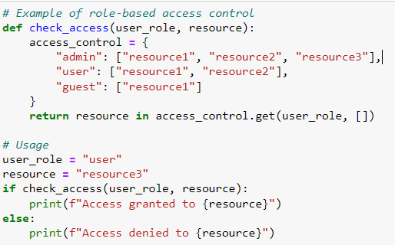
OWASP top 10 - Broken Access Control example

Slide 52
OWASP top 10 - Security Misconfiguration
Description: Security misconfiguration vulnerabilities occur when security settings are defined, implemented, and maintained improperly.
Impact: Attackers can exploit misconfigured settings to gain unauthorized access.
How to Secure:
Implement a repeatable hardening process.
Regularly audit and update configurations.

Slide 53
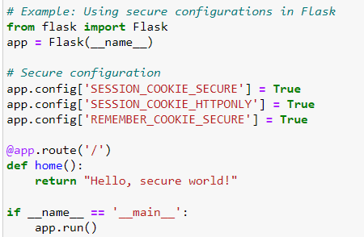
OWASP top 10 - Security Misconfiguration example

Slide 54
OWASP top 10 - Cross-Site Scripting (XSS)
Description: XSS vulnerabilities occur when untrusted data is included in web pages without proper validation or escaping.
Impact: Attackers can execute scripts in the user's browser, hijack user sessions, or redirect users to malicious sites.
How to Secure:
Validate and sanitize input data.
Encode output data.

Slide 55
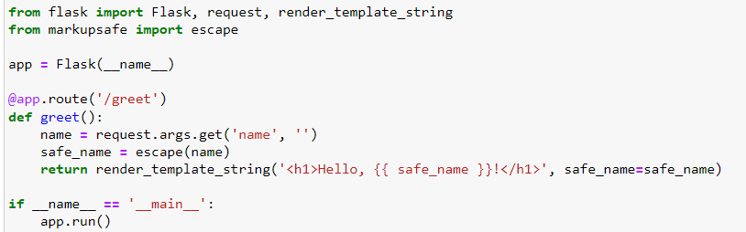
OWASP top 10 - Cross-Site Scripting (XSS) example

Slide 56
OWASP top 10 - Insecure Deserialization
Description: Insecure deserialization vulnerabilities occur when untrusted data is used to abuse the logic of an application, inflict a denial of service (DoS) attack, or execute arbitrary code.
Impact: Attackers can execute arbitrary code or perform unauthorized actions.
How to Secure:
Avoid using serialized objects from untrusted sources.
Use serialization formats that support integrity checks.

Slide 57
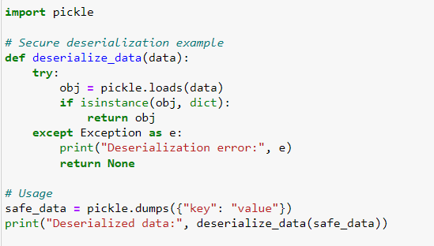
OWASP top 10 - Insecure Deserialization example

Slide 58
OWASP top 10 - Using Components with Known Vulnerabilities
Description: Using components with known vulnerabilities can expose applications to attacks.
Impact: Attackers can exploit vulnerabilities in third-party components to compromise the application.
How to Secure:
Regularly update and patch components.
Use tools to identify vulnerable components.

Slide 59
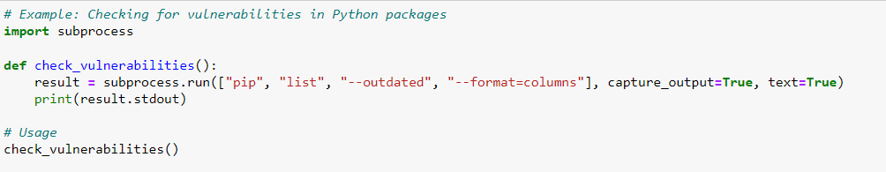
OWASP top 10 - Using Components with Known Vulnerabilities example

Slide 60
OWASP top 10 - Insufficient Logging & Monitoring
Description: Insufficient logging and monitoring can delay the detection of security breaches.
Impact: Attackers can exploit the lack of monitoring to continue their attacks undetected.
How to Secure:
Implement comprehensive logging and monitoring.
Regularly review and analyze logs.

Slide 61
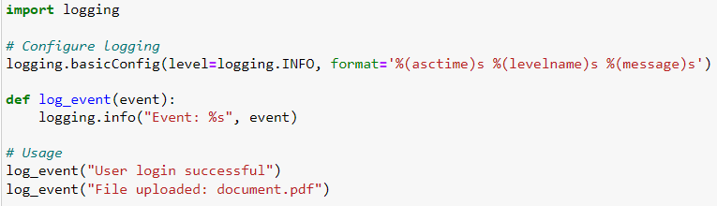
OWASP top 10 - Insufficient Logging & Monitoring example

Slide 62
OWASP Projects
OWASP sponsors and supports various open-source projects related to web application security.
Scope: These projects cover a wide range of security topics, including secure coding, vulnerability scanning, and penetration testing.
Objective: To provide free, high-quality tools and resources that help developers and security professionals improve the security of their web applications.
Categories:
Tools and utilities
Documentation and guides
Educational and training resources

Slide 63
OWASP Projects- Zed Attack Proxy (ZAP)
ZAP is an open-source tool used for finding vulnerabilities in web applications.
Purpose: Ideal for both beginners and professionals to perform security testing on web applications.
Key Features:
Automated scanners
Passive and active scanning
Manual testing tools
Integration with other tools
Tutorial: https://www.youtube.com/watch?v=3u7aKXXCCKA

Slide 64
OWASP Projects- OWASP Dependency-Check
A Software Composition Analysis (SCA) tool that identifies vulnerable components in project dependencies.
Purpose: Helps in identifying and mitigating risks associated with third-party libraries.
Key Features:
Supports multiple languages and dependency management systems
Generates detailed reports
Integrates with CI/CD pipelines
Tutorials: https://www.youtube.com/watch?v=DF22sTpcE6w https://www.youtube.com/watch?v=X47ZkdYnGZI

Slide 65
OWASP – Web Application Security Testing
WASP offers guidelines, tools, and resources for testing the security of web applications, helping organizations identify and address vulnerabilities.
OWASP Web Security Testing Guide (WSTG): Although not a tool in the software sense, WSTG is a comprehensive guide for testing the security of web applications and services. It provides a standardized approach to web application security testing.
Features: Includes detailed instructions and best practices for testing various security aspects of web applications, including authentication, authorization, session management, and data validation.

Slide 66
NIST’s Secure Software Development Framework
The National Institute of Standards and Technology (NIST) released various guidelines and frameworks for secure software development.
One of the critical resources NIST provides is the NIST Secure Software Development Framework (SSDF), designed to help organizations enhance the security of their software development processes.

Slide 67
Secure Software Development Guidelines
Example: Using the NIST Special Publication 800-53 as a guide for security controls.
Tool: JIRA - Can be customized to track and manage security requirements and tasks throughout the development lifecycle.

Slide 68
NIST Secure Software Development Principles
Description: The framework promotes fundamental security principles and best practices that should be integrated into every phase of the software development life cycle (SDLC).
These principles include secure coding, security testing, threat modeling, and secure software architecture.
Purpose: To embed security considerations into the DNA of the development process, making security a primary concern rather than an afterthought.

Slide 69
NIST’s Security Standards and References
Description: NIST’s SSDF references various security standards, guidelines, and resources that can help organizations implement secure software development practices effectively.
This includes NIST Special Publications, industry standards, and other authoritative sources.
Purpose: To provide a robust foundation of trusted and proven security practices that organizations can rely on to enhance their software security posture.

Slide 70
NIST’s Security Standards and References
Example: Adopting the CIS Controls framework for implementing a robust cybersecurity posture.
Tool: NIST Cybersecurity Framework (CSF) Tool - A tool that helps organizations align their security practices with NIST standards.

Slide 71
NIST’s Security Risk Management:
Description: The framework emphasizes the importance of risk management throughout the software development process.
It encourages organizations to identify, assess, and mitigate security risks associated with their software projects.
Purpose: To proactively manage and reduce security risks, ensuring that potential vulnerabilities are addressed before they can be exploited.

Slide 72
NIST’s Security Risk Management
Example: Conducting regular threat modeling sessions using the STRIDE methodology to identify and mitigate risks.
Tool: Microsoft Threat Modeling Tool - Helps create and analyze threat models for applications.

Slide 73
NIST’s Integration with Existing Processes
Description: NIST’s SSDF is designed to be flexible and adaptable.
Organizations can integrate its guidance and recommendations into their existing software development processes, including Agile and DevOps methodologies.
Purpose: To facilitate the adoption of secure software development practices without disrupting established workflows, making it easier for organizations to improve their security posture.

Slide 74
NIST’s Integration with Existing Processes
Example: Integrating security checkpoints into an Agile development workflow using Scrum.
Tool: GitLab CI/CD - Can be configured to include security tests as part of the continuous integration and delivery pipeline.

Slide 75
NIST’s Security Training and Awareness
The framework underscores the significance of training and raising awareness among developers, testers, and other stakeholders regarding secure coding practices and the implications of security vulnerabilities.
Purpose: To ensure that all individuals involved in the software development process understand the importance of security and are equipped with the knowledge and skills to implement secure practices.

Slide 76
NIST’s Security Metrics and Measurement
NIST’s SSDF encourages organizations to define and track security metrics to assess the effectiveness of their secure software development initiatives. Metrics can help identify areas for improvement and evaluate the impact of security measures.
Purpose: To provide a quantitative basis for evaluating and improving the security of software development processes, leading to more effective and measurable security practices.

Slide 77
Secure SDLC
NIST’s SSDF promotes incorporating security activities into the entire SDLC, from initial planning and requirements to post-deployment maintenance and monitoring.
Purpose: To ensure that security is a continuous consideration throughout the entire lifecycle of software development, resulting in more secure and resilient software applications.

Slide 78
Continuous Improvement
The framework emphasizes continuous improvement by learning from security incidents, security assessments, and feedback from the development process. It encourages organizations to adapt and refine their practices over time.
Purpose: To foster a culture of ongoing improvement in software security practices, enabling organizations to stay ahead of emerging threats and vulnerabilities.

Slide 79
MITRE Frameworks
MITRE Corporation is a not-for-profit organization that operates Federally Funded Research and Development Centers (FFRDCs) in the United States.
One of MITRE’s key contributions to software security is the development and maintenance of the Common Weakness Enumeration (CWE) and Common Vulnerabilities and Exposures (CVE) standards

Slide 80
Common Vulnerabilities and Exposures (CVE)
CVE: Focuses on documenting specific instances of vulnerabilities in software products.
Each CVE entry describes a particular vulnerability and provides an identifier, description, and references to more detailed information.
Deals with individual vulnerabilities that have been identified in specific software products. It is a database of known vulnerabilities with unique identifiers (e.g., CVE-2023-12345).
Contains entries that include the CVE ID, a brief description of the vulnerability, and references to additional details such as advisories, patches, and reports.
Used by security professionals to identify and track specific vulnerabilities in software products. It helps in vulnerability management, patch management, and incident response.

Slide 81
CVE example
CVE-2023-12345: This might describe a specific buffer overflow vulnerability found in version 2.3.4 of a software product. It would include a brief description, an identifier, and links to detailed reports and patches.

Slide 82
Common Weakness Enumeration (CWE)
Focuses on the classification and categorization of types of software weaknesses that can lead to vulnerabilities.
CWE provides a hierarchical list of software weaknesses, detailing the nature of the weakness and its potential impact.
Deals with the broader classes of software weaknesses and coding errors that could potentially lead to vulnerabilities. It provides a taxonomy of these weaknesses to help developers understand and prevent them (e.g., CWE-79 for Cross-Site Scripting).
Contains entries that describe the nature of weaknesses, examples of how they can be introduced, potential consequences, and mitigation strategies.
Used by developers, security researchers, and educators to understand common types of software weaknesses. It is used in secure coding practices, software assurance programs, and training.

Slide 83
CWE exmaple
CWE-120: This describes the general class of "Buffer Copy without Checking Size of Input ('Classic Buffer Overflow')."
It explains what a buffer overflow is, how it can be introduced into software, and ways to prevent it.

Slide 84
MITRE ATT&CK Framework
The MITRE Adversarial Tactics, Techniques, and Common Knowledge (ATT&CK) framework is a knowledge base that describes the actions and behaviors of cyber adversaries. It provides a comprehensive view of adversaries’ various tactics and techniques to achieve their objectives.
The ATT&CK framework catalogs the tactics and techniques used by adversaries to infiltrate networks, maintain persistence, escalate privileges, and achieve their objectives.
It includes detailed descriptions of each tactic and technique, as well as the specific methods adversaries use to carry them out.
The framework is continually updated with information gathered from real-world observations and cybersecurity research.

Slide 85
MITRE ATT&CK Framework use case examples
Threat Hunting: Security teams use the ATT&CK framework to proactively search for indicators of compromise (IOCs) and adversary behaviors within their networks.
Incident Response: Incident responders leverage the framework to understand the tactics and techniques used in an ongoing attack and to develop effective mitigation strategies.
Security Posture Assessment: Organizations assess their defenses against the tactics and techniques described in the ATT&CK framework to identify gaps and weaknesses.
Red Teaming and Penetration Testing: Red teams use the ATT&CK framework to simulate adversary behaviors and test the effectiveness of security controls.
Security Operations Center (SOC) Automation: The framework is integrated into SOC tools and platforms to automate the detection and response to known adversary techniques.

Slide 86
MITRE ATT&CK Framework: key components
Tactics: The "why" of an adversary's behavior, representing the goal they are trying to achieve. Examples include Initial Access, Execution, Persistence, Privilege Escalation, Defense Evasion, Credential Access, Discovery, Lateral Movement, Collection, Command and Control, Exfiltration, and Impact.
Techniques: The "how" of an adversary's behavior, detailing the specific methods used to achieve a tactic. Each technique includes information on the procedure, detection, mitigation, and examples of real-world usage.
Sub-Techniques: Further granularity within techniques, providing more specific details about how an adversary performs a particular technique.
Procedures: Real-world instances of how adversaries have implemented tactics and techniques, including examples from cyber threat intelligence reports.

Slide 87
Most common SDLC models
Although SDLC is a standardized method to develop Software, the implementation however differs depending on the needs of the organization.
Waterfall Model
Agile Model
Scrum
Kanban
Iterative Model
Spiral Model
DevOps
V-Model (Validation and Verification Model)
Rapid Application Development (RAD)
Big Bang Model

Slide 88
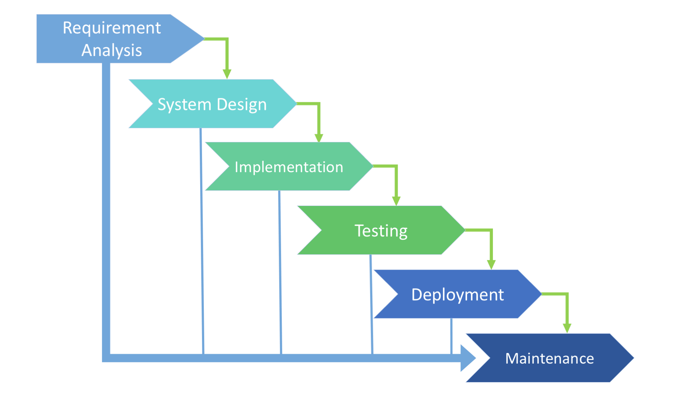
Waterfall SDLC
https://existek-838c.kxcdn.com/wp-content/uploads/2017/08/Itterative-SFDC-Model.png

Slide 89
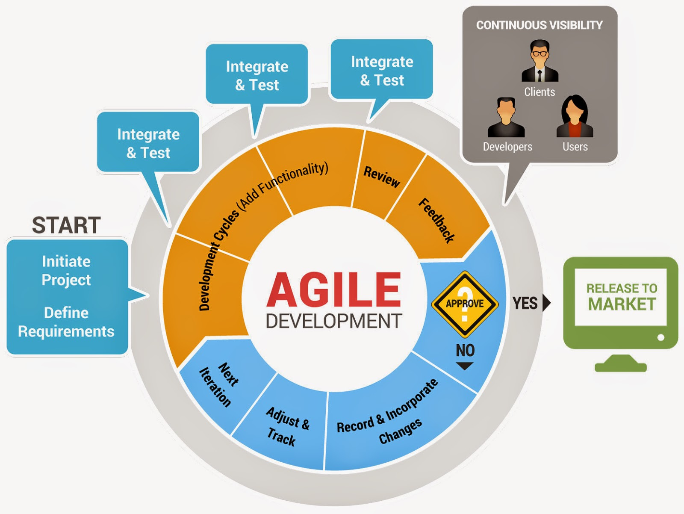
Agile SDLC
https://4.bp.blogspot.com/-YqfVxrkO-Jk/VBiLJG7kY3I/AAAAAAAABv8/3L_341MB0Z0/s1600/Agile-sdlc.jpg

Slide 90
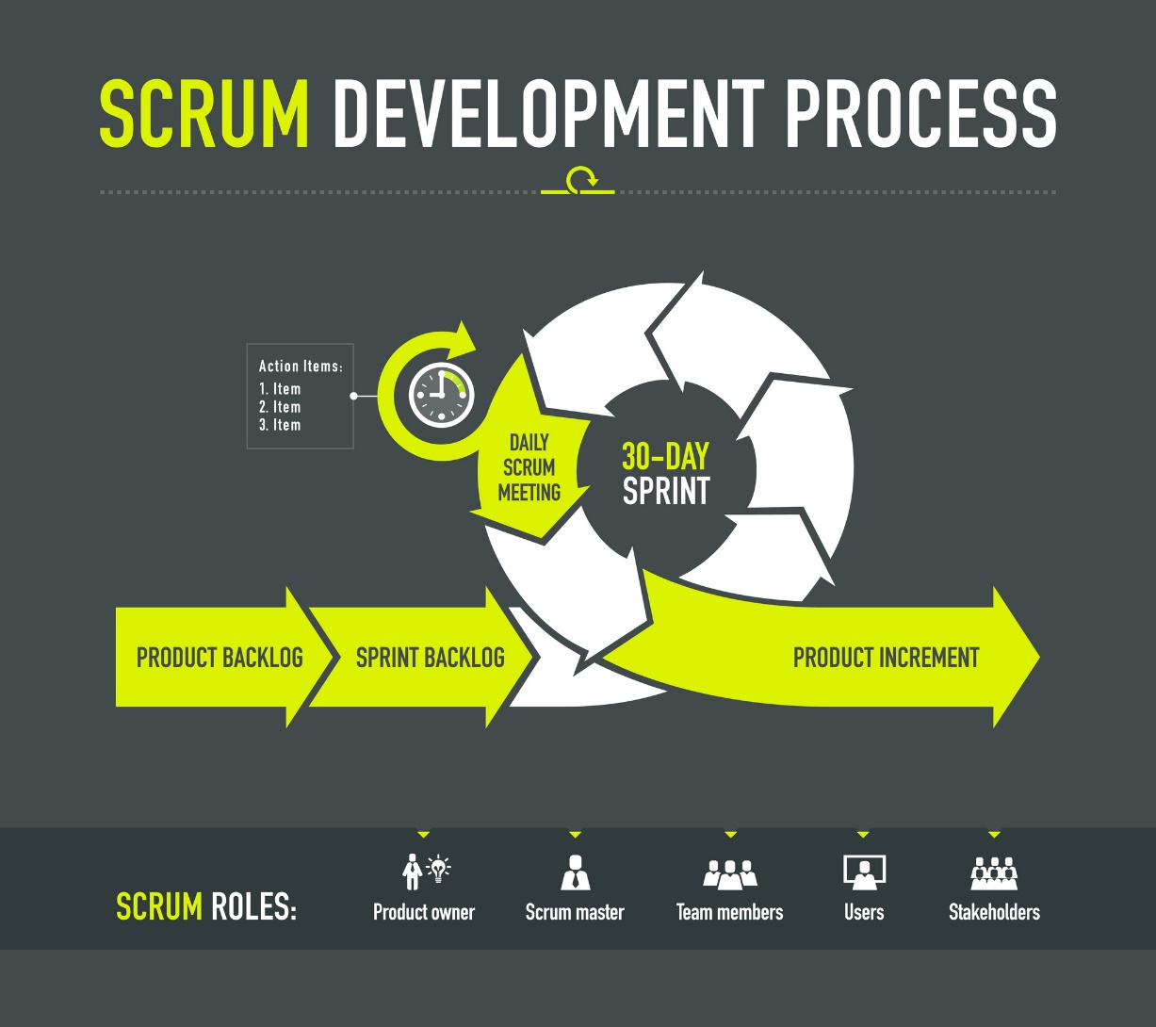
SCRUM SDLC
http://projektwelten.projectplant.de/wp-content/uploads/2016/07/ProjectPlant_ScrumMethode_Ueberblick.jpg

Slide 91
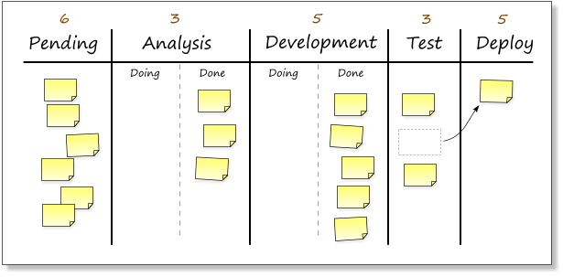
KANBAN SDLC
https://kanbanblog.com/explained/image/kanban-board-2.png

Slide 92
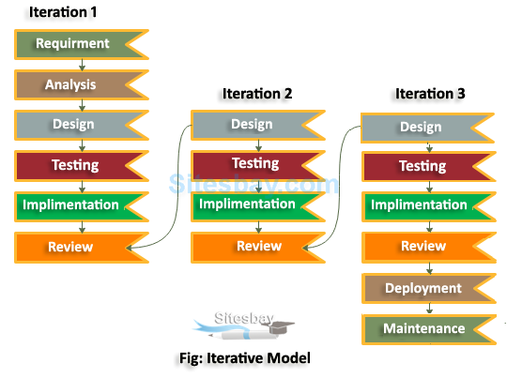
ITTERATIVE SDLC
https://external-content.duckduckgo.com/iu/?u=https%3A%2F%2Fwww.sitesbay.com%2Fsoftware-engineering%2Fimages%2Fiterative-model-in-sdlc.png&f=1&nofb=1&ipt=66e1e14e4987c5ec8ff767ccb13b050adf569f58580bb6f62af4b03ac21e1709&ipo=images

Slide 93
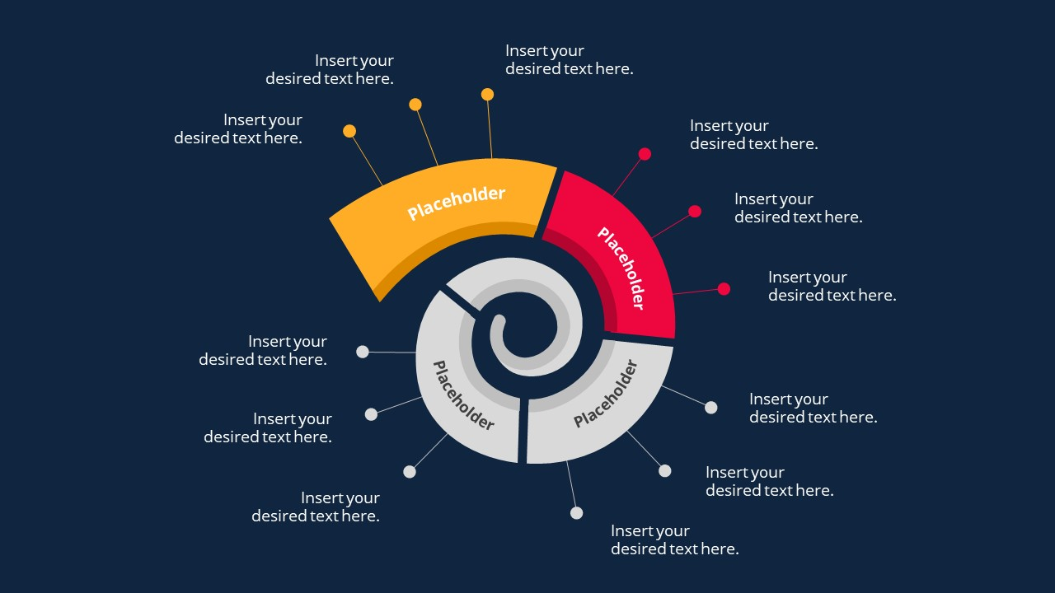
SPIRAL SDLC
https://external-content.duckduckgo.com/iu/?u=https%3A%2F%2Fcdn.slidemodel.com%2Fwp-content%2Fuploads%2F20539-01-spiral-diagram-concept-for-powerpoint-16x9-9.jpg&f=1&nofb=1&ipt=02c7185255f9c825972775f0f22fcfa6877f8271ce44838e61dfb033d9c73864&ipo=images

Slide 94
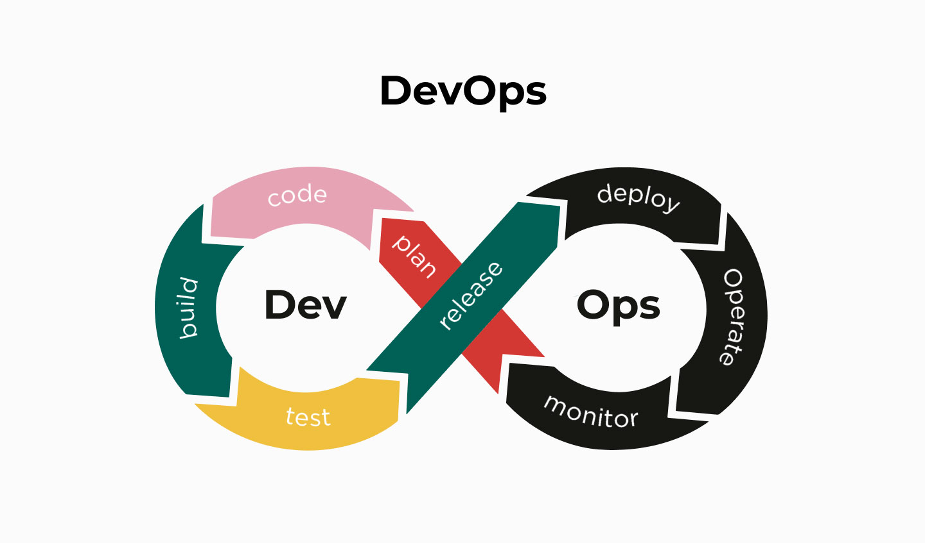
DevOPS SDLC
https://external-content.duckduckgo.com/iu/?u=https%3A%2F%2Fthemindstudios.com%2Fblog%2Fcontent%2Fimages%2F2020%2F01%2FDevOps.jpg&f=1&nofb=1&ipt=5ca681d573ac2d4b1a12dfb9c08271a1a77c17f39458e0cb45434c9df9b52e09&ipo=images

Slide 95
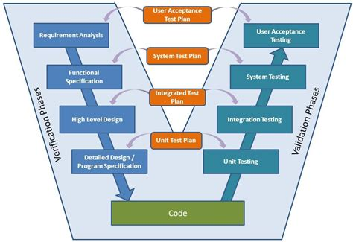
V-Model (Validation and Verification Model)
https://external-content.duckduckgo.com/iu/?u=https%3A%2F%2Ftse2.mm.bing.net%2Fth%3Fid%3DOIP.9hfM8Zz0blYY6viv2AsXHgHaFF%26pid%3DApi&f=1&ipt=a106f6df97b7d0b89c06de8e195cab0ff029cee62175a6ead02faab9a49d3aa7&ipo=images

Slide 96
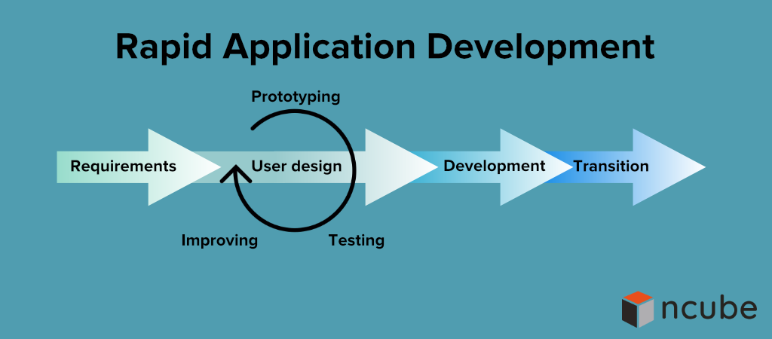
RAD SDLC

Slide 97
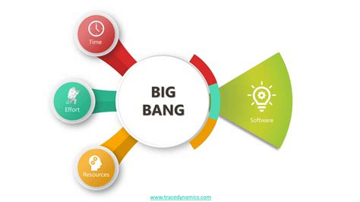
BIG BANG SDLC

Slide 98
SDLC models – Comparison
Aspect | Waterfall Model | Agile Model | Scrum | Kanban | Iterative Model
Flexibility | Low - sequential process, difficult to change | High - iterative and adaptive | High - iterative with regular adjustments | High - continuous flow, dynamic adjustments | Medium - iterative cycles allow adjustments
Customer Involvement | Low - limited to initial and final phases | High - continuous collaboration and feedback | High - regular involvement in sprints | High - ongoing feedback through board updates | Medium - feedback at the end of each iteration
Risk Management | Low - risks addressed late in process | High - continuous risk assessment and mitigation | High - risks managed within sprints | Medium - risks managed as work progresses | Medium - risks addressed per iteration
Delivery Speed | Slow - follows a strict sequence | Fast - delivers usable increments regularly | Fast - delivers usable increments per sprint | Continuous - work is delivered as completed | Medium - delivers usable parts per iteration
Best Suited For | Stable, well-defined requirements | Evolving or unclear requirements | Projects needing regular delivery of features | Continuous delivery and dynamic management | Projects needing ongoing refinement and feedback

Slide 99
SDLC models – Comparison
Aspect | Spiral Model | DevOps | V-Model | RAD | Big Bang Model
Flexibility | High - iterative with risk-based approach | High - integrates continuous delivery practices | Low - follows strict verification phases | High - focuses on rapid prototyping | Very High - minimal planning
Customer Involvement | High - involved in each cycle and risk assessment | High - continuous collaboration and feedback | Low - limited to initial and final phases | High - ongoing feedback in rapid cycles | Low - limited involvement
Risk Management | Very High - central to the model | High - continuous monitoring and mitigation | Medium - testing linked to each phase | Medium - iterative feedback reduces risks | Very Low - risks often unaddressed
Delivery Speed | Medium - iterative but thorough | Very Fast - continuous integration and delivery | Slow - follows a strict sequence | Very Fast - rapid cycles and feedback | Unpredictable - no structured process
Best Suited For | Large, complex projects with high risks | Projects needing rapid, reliable deployments | Stable, well-understood requirements | Fast time-to-market projects | Small, experimental projects

Slide 100
Microsoft’s Security Development Lifecycle (SDL)
A major issues with the “old” traditional SDLC was the absence, or the lack of attention, of security aspect.
Security was not the major goal when designing software
Developers wants to get things done ASAP.

Slide 101
Traditional SDLC vs Microsoft’s SDL
Aspect | Traditional SDLC | Microsoft SDL
Focus | Functionality and performance | Security throughout all phases
Security Integration | Security often addressed in testing phase | Security integrated into every phase
Risk Management | Managed within phases, sometimes reactive | Proactive, continuous risk management
Training | Not typically included | Mandatory security training for all personnel
Verification | Functional and performance testing | Comprehensive security testing (static, dynamic, fuzz)
Threat Modeling | Rarely included | Integral part of the design phase
Post-Release | Maintenance and bug fixes | Incident response and continuous monitoring
Tools and Practices | General development tools | Use of approved security tools and best practices

Slide 102
SDLC vs. MS SDL: Deeper comparison
Aspect | Traditional SDLC | Microsoft SDL
Primary Focus | Functionality, performance, meeting user requirements | Security integrated throughout the development process
Phases | Requirements, Design, Implementation, Testing, Deployment, Maintenance | Training, Requirements, Design, Implementation, Verification, Release, Response
Security Integration | Primarily during testing phase | Integrated into every phase
Risk Management | Managed within specific phases, often reactive | Proactive and continuous risk management
Training | Not typically included | Mandatory security training for all personnel
Requirements Phase | Focus on functional requirements | Security requirements defined alongside functional requirements
Design Phase | Emphasis on system and software architecture | Includes threat modeling and secure design principles
Implementation Phase | Coding and development of the software | Enforces secure coding practices and use of approved tools
Verification Phase | Functional and performance testing | Comprehensive security testing (static analysis, dynamic analysis, fuzz testing)
Aspect | Traditional SDLC | Microsoft’s SDL
Release Phase | Deployment and transition to maintenance | Final security review and incident response planning
Response Phase | Maintenance and bug fixes | Continuous monitoring and response to security incidents
Threat Modeling | Rarely included | Integral part of the design phase
Security Testing | Basic functional and performance testing | Extensive security testing (static, dynamic, fuzz)
Incident Response | Limited, reactive maintenance | Proactive incident response and continuous monitoring
Use of Tools | General development tools | Use of approved security tools and best practices
Continuous Improvement | Focus on functional updates | Emphasizes learning from incidents and improving security practices
Flexibility | Sequential, changes difficult after phase completion | Iterative, allows for changes and continuous improvement
Documentation | Comprehensive documentation at each phase | Comprehensive documentation with security focus
Customer Involvement | Mainly during requirements and final delivery | Continuous collaboration and feedback
Development Speed | Slower, due to sequential phases | Can be faster, especially in identifying and mitigating security issues early
Best Suited For | Projects with stable, well-defined requirements | Projects with high security needs, complex environments

